Slide 1

PhD-Research Knowledge Collaboration Tool
PRESENTED BY:
TEAM - 32

Slide 2

Project Details
01
02
03
04
Searching the Research Paper based on:
Title
Author
Topic
Graph Visualization
based on categories like cs.AI, math.IT, etc.
Capture comments/ideas that can be displayed later when viewing similar papers
Bookmark the page and add it to the User library

Slide 3
Implementation
01
Implemented User Signup and Login
02
Session Management with Routing Restrictions
03
Search Paper based on Title attribute.
04
Displaying Title, Author, DOI, Abstract of the Searched Paper
05
Bookmark to Add and Remove Pages to/from User Library

Slide 4
Implementation
06
Feature to Add Comments/Summary to a Research Paper
07
Retrieve Comments/Summary of the Papers when searched later
08
Feature to Update/Remove the Comments/Summary of a Research Paper.
09
Redirection to Global Library to Download the Research Paper
10
Graphical Visualization of related Papers

Slide 5
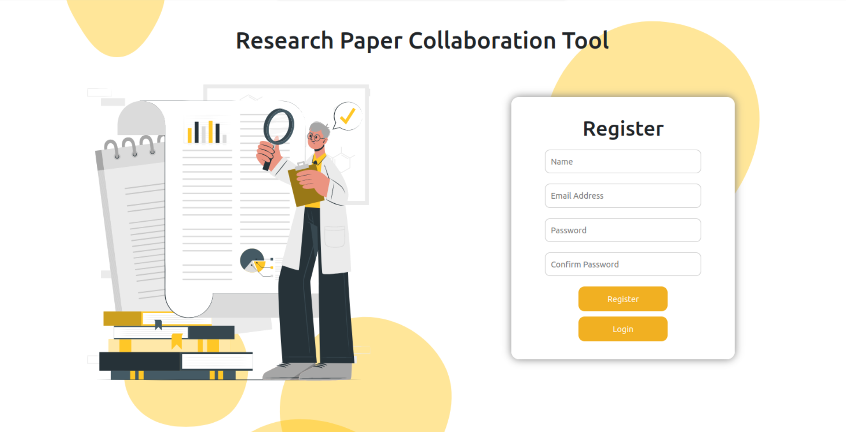
Registration Page

Slide 6
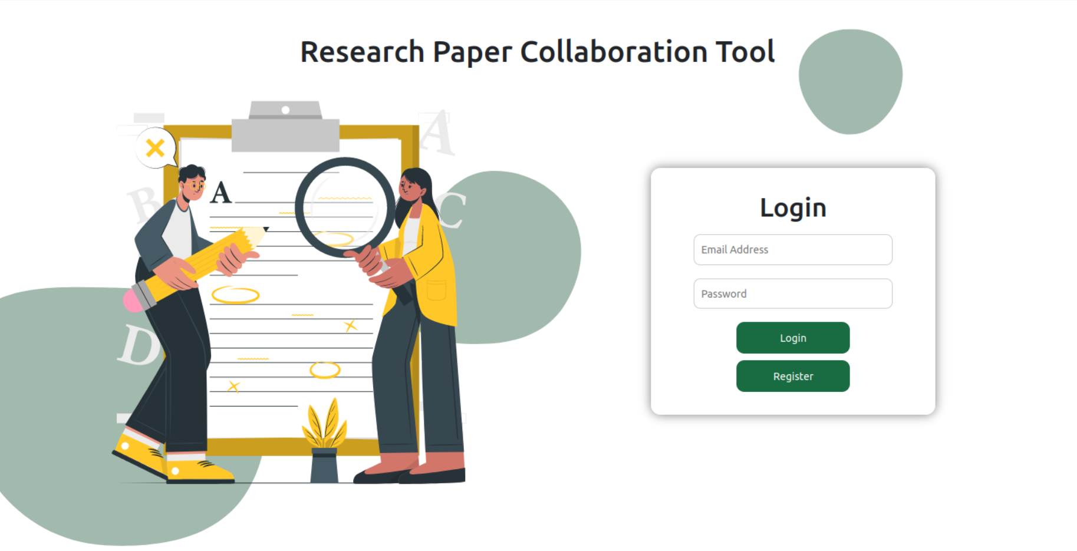
Login Page

Slide 7
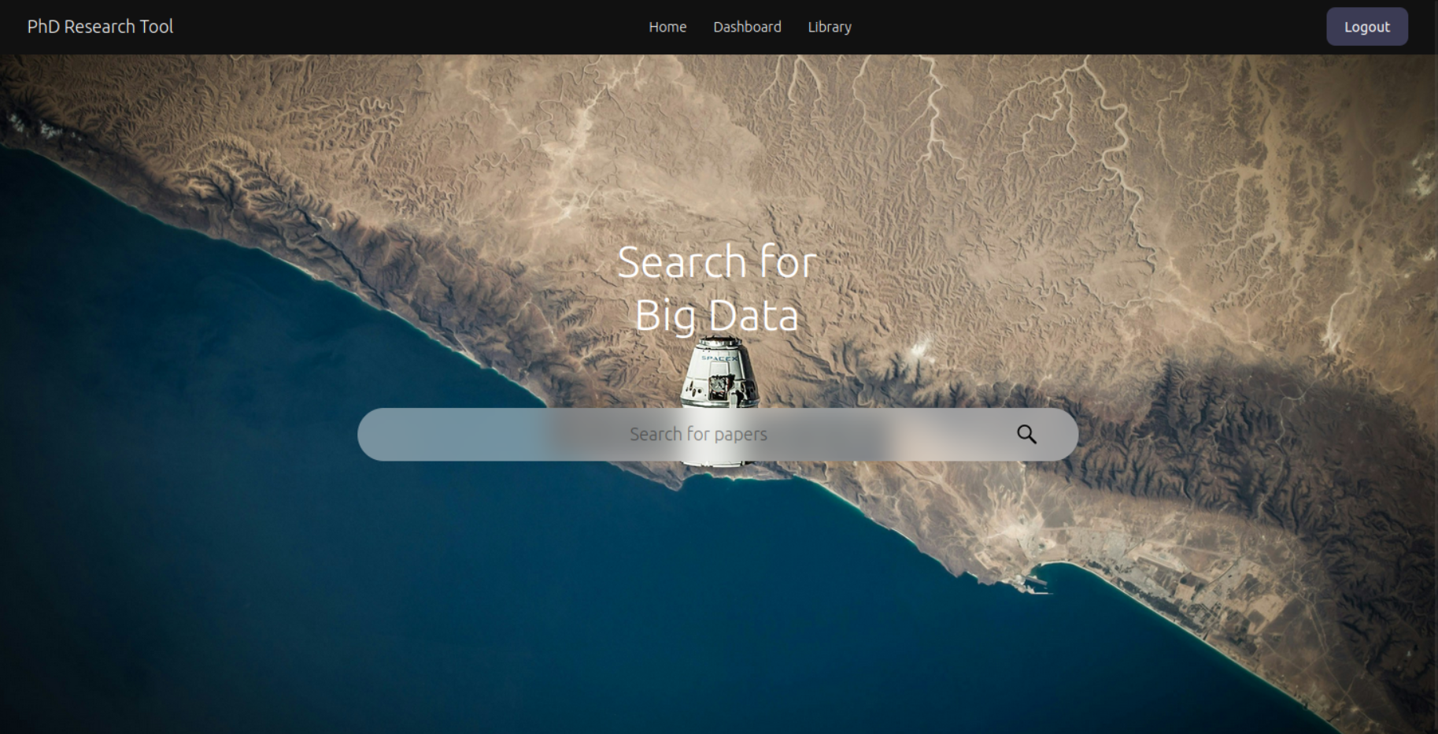
Home Page

Slide 8
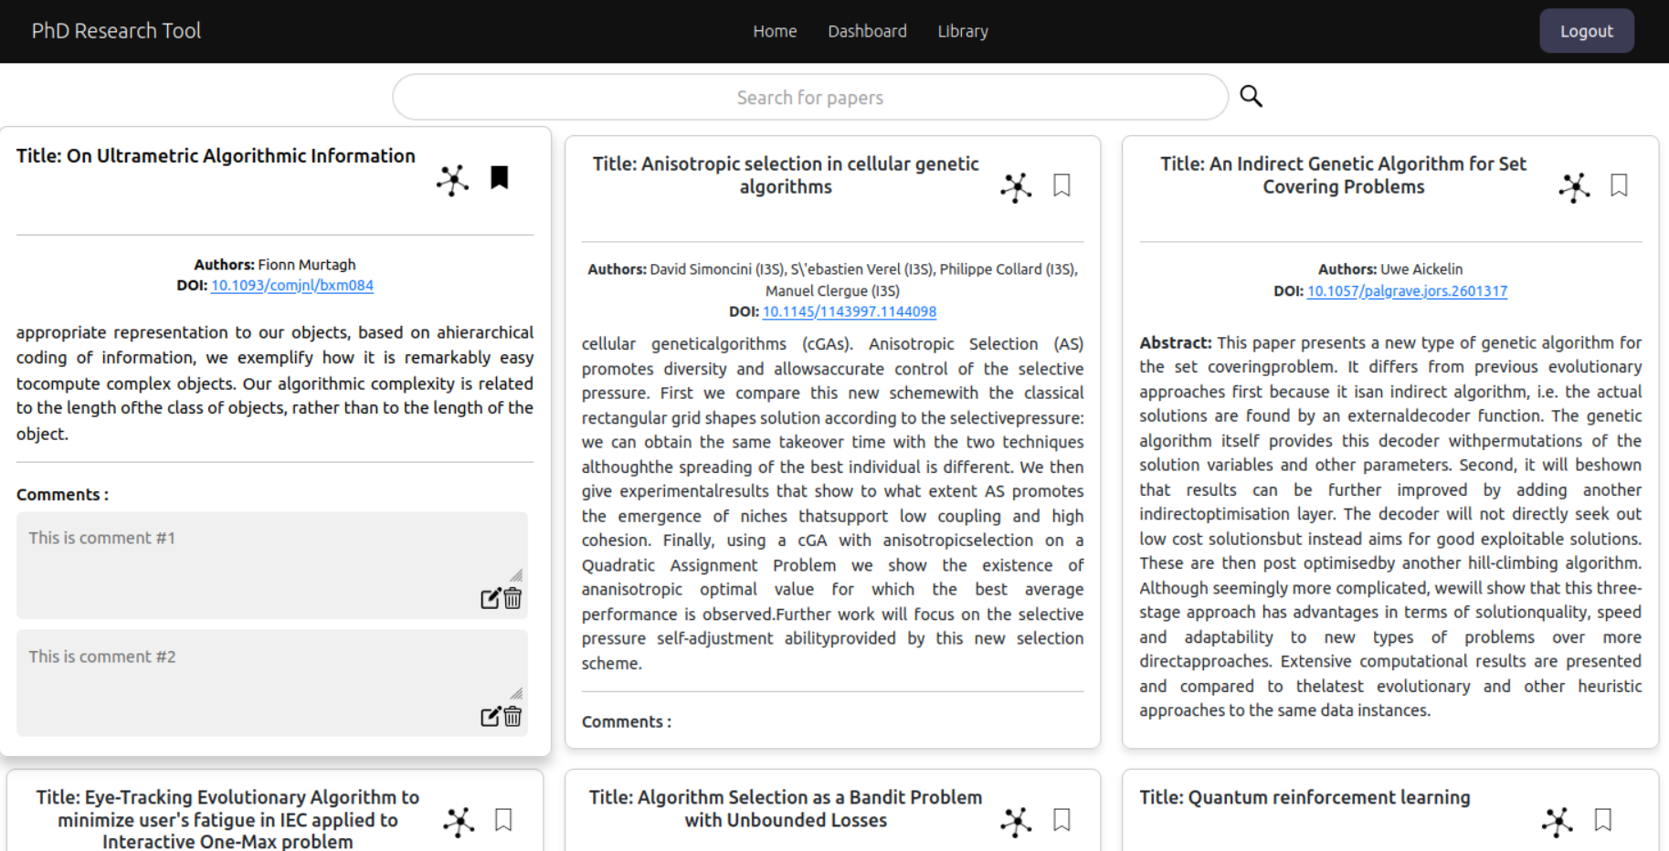
Dashboard

Slide 9
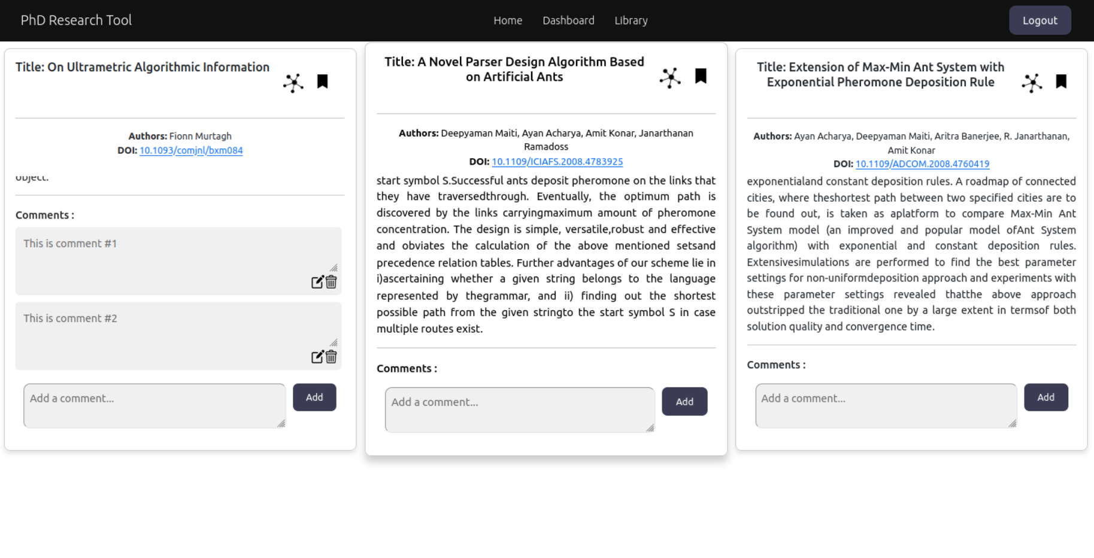
Library

Slide 10
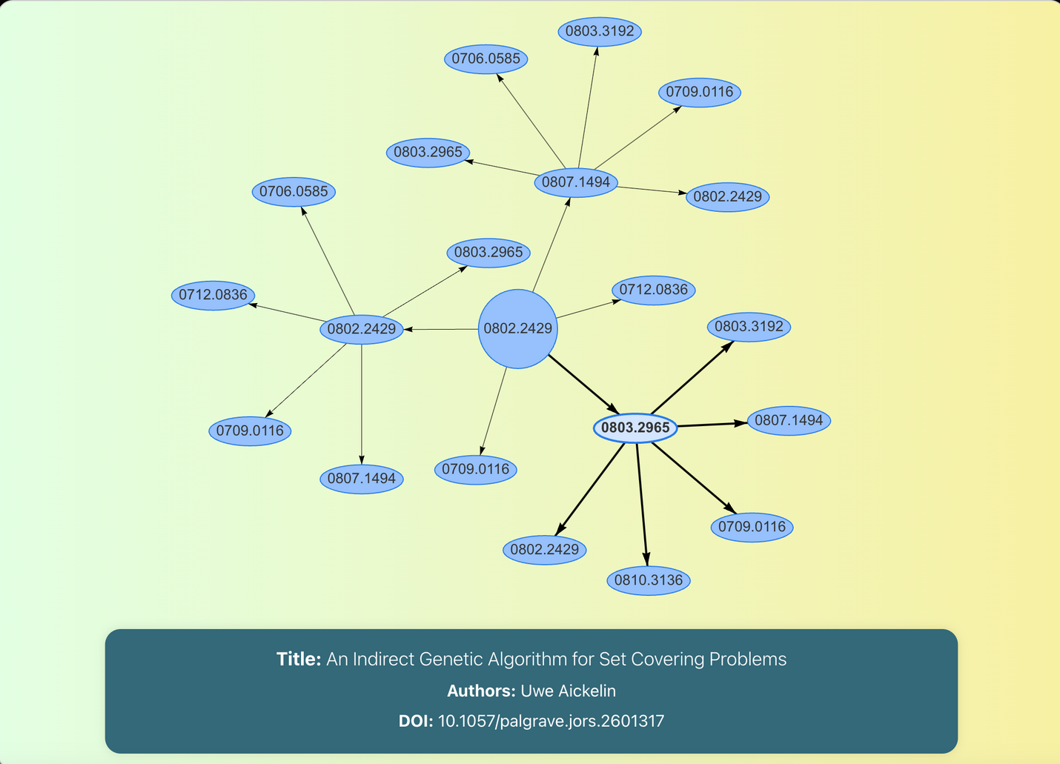
Graphical Visualization

Slide 11

Scope
The project aims to offer the PhD students a solution to make notes on the papers they read and revisit those ideas later. It has a Recommendation engine built-in for efficient search.
PhD Students
Research Scholars

Slide 12
TechStack
Frontend
HTML, CSS, JavaScript, ReactJS
Dataset
Backend
NodeJS, ExpressJS, Python, Flask
Database
MongoDB
Dataset
Arxiv.org STEM dataset

Slide 13

Back to Agenda
Thank You!!

